Slide 1
Project Presentation of Industry Oriented Hands on Experience (22CS422)
On
Comparative Analysis of Machine Learning
Models for Employee Attrition Prediction
Chetan Kumar (2210991458)
Raghav Sarochya(2210992122)
Aryan(2210990174)
Supervised By
Dr. Gurpreet Singh
Department of Computer Science and Engineering,
Chitkara University, Punjab

Slide 2
Contents
1. Introduction
Literature Review
Tools and Technologies
3. Fundamental Concepts
4. Experimental Methodology
5. Results & Discussion
6. Applications
7. Limitations
8. Conclusion & Future Scope
9. References

Slide 3
Introduction
Context & Problem Statement
Rapid digital transformation has increased the volume of employee-related data available to organizations.
High employee attrition impacts productivity, recruitment cost, team stability, and organizational growth.
HR departments often rely on reactive approaches such as resignation analysis and feedback surveys.
Traditional methods fail to provide early prediction of employee turnover risks.
Machine Learning offers data-driven predictive insights that help organizations take preventive actions.
Research Objective
Build and compare three Machine Learning models for employee attrition prediction:
Logistic Regression
Decision Tree
Random Forest
Use the IBM HR Analytics Employee Attrition dataset for experimentation and evaluation.
Perform data preprocessing, feature selection, and exploratory data analysis (EDA).
Evaluate model performance using standardized metrics such as:
Accuracy
Precision
Recall
3

Slide 4
Literature Review
Traditional Approaches
Employee attrition has traditionally been analyzed using exit interviews, employee feedback forms, and satisfaction surveys.
These methods provide qualitative insights into employee behavior and workplace challenges.
However, such approaches are retrospective in nature, meaning organizations gain insights only after employees leave the company.
ML in HR Analytics
Machine Learning has emerged as a powerful tool in Human Resource Analytics for predicting employee attrition.
ML models can analyze large volumes of workforce data and discover complex relationships between employee attributes and turnover behavior.
Research Gap
Existing studies often focus on a single machine learning model rather than providing a comprehensive comparison among multiple algorithms.
Many research works use different datasets, preprocessing methods, and evaluation metrics, making fair comparison difficult.

Slide 5
Tools And Technologies
Programming Language: Python 3.x Used for implementing machine learning models, data preprocessing, and visualization tasks.
Machine Learning Framework: scikit-learn Used to build and evaluate models such as Logistic Regression, Decision Tree, and Random Forest.
Data Handling & Preprocessing:
pandas — Used for loading, cleaning, and preprocessing the dataset.
NumPy — Used for numerical computations and array operations.
Data Visualization Tools:
Matplotlib — Used for generating graphs and performance charts.
Seaborn — Used for advanced visualizations such as confusion matrix heatmaps.
Development Environment:
Jupiter Notebook — Used for coding, testing, and model execution.
Google Colab — Cloud-based notebook platform used to run the project.
Dataset Used:
IBM HR Analytics Employee Attrition Dataset Used for analyzing employee behavior and predicting attrition using machine learning algorithms.

Slide 6




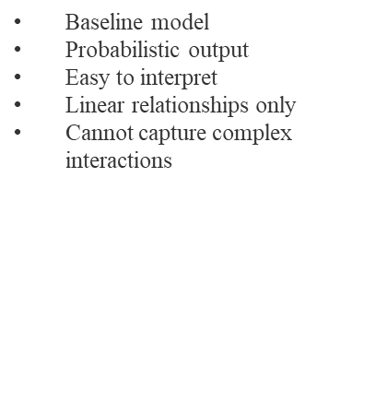
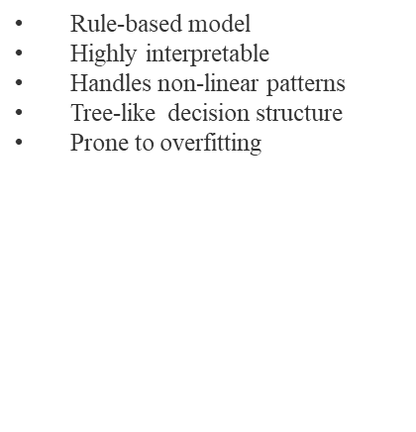
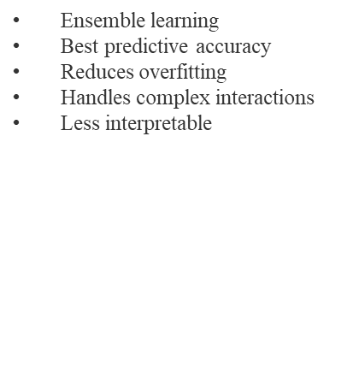
Machine learning Models
Decision
Tree

Slide 7
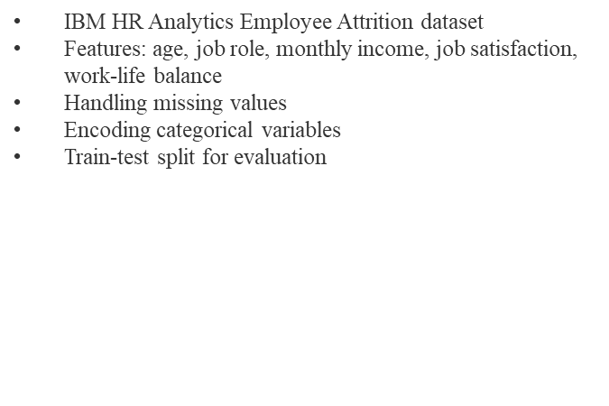
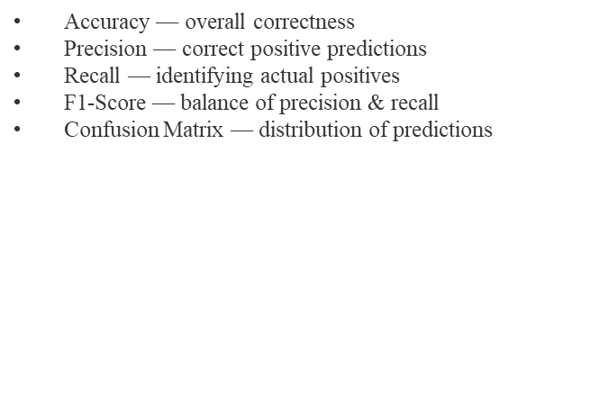
Experimental Methodology

Slide 8
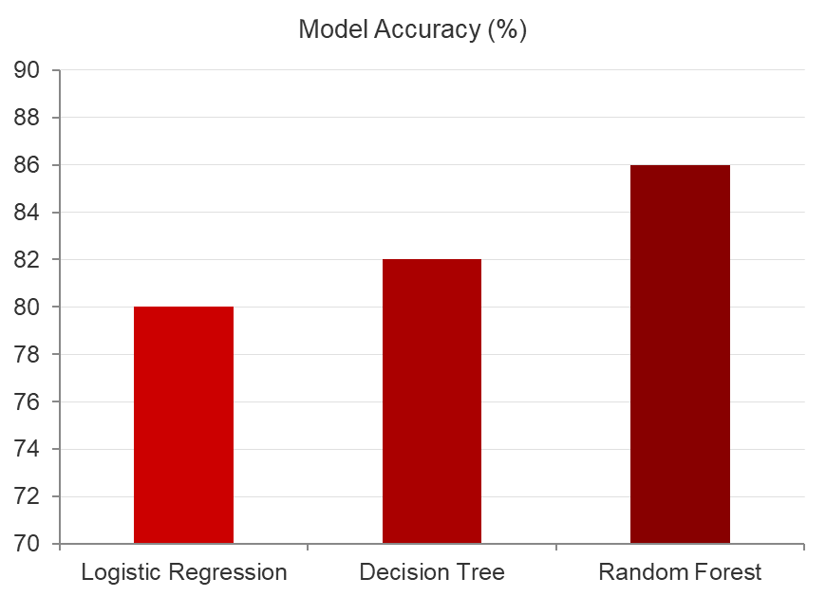
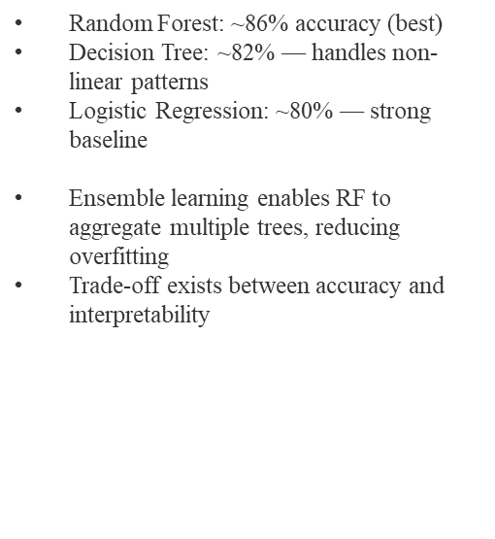
Results: Model Performance Comparison
Key Findings

Slide 9
Why Random Forest Achieved Higher Accuracy
Random Forest is an ensemble learning algorithm that combines predictions from multiple decision trees to improve overall performance and stability.
Instead of relying on a single tree, the model aggregates outputs from many trees using majority voting, leading to more reliable predictions.
The algorithm reduces overfitting by introducing randomness in both data sampling and feature selection during training.
Random Forest can effectively capture complex and non-linear relationships between HR variables such as overtime, monthly income, job satisfaction, and work-life balance.
It performs well with mixed data types, including both numerical and categorical employee attributes.
The model is less sensitive to noise and outliers compared to individual decision trees.
Feature bagging enables the algorithm to identify the most important predictors of employee attrition more effectively.

Slide 10
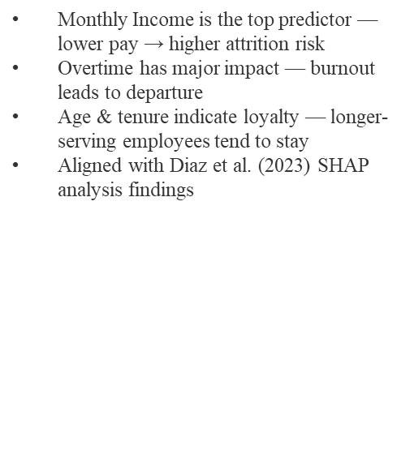
Results: Feature Importance Analysis
Results: Feature Importance Analysis
Insights

Slide 11





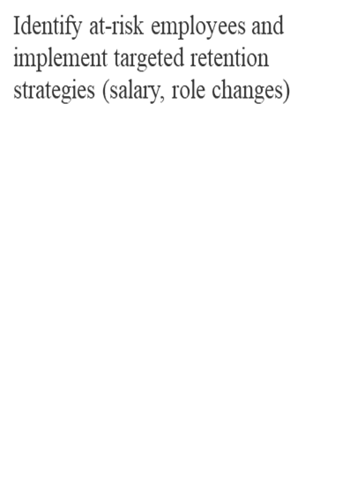
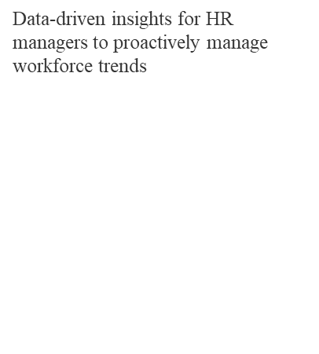
Applications
Workforce
Retention
HR Decision
Support
Reduce recruitment & training costs by predicting and preventing attrition

Slide 12
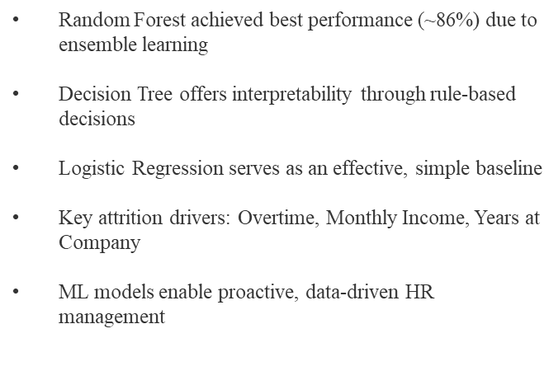
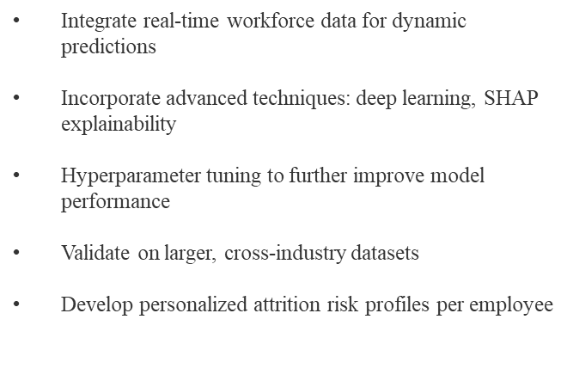
Conclusion and Future Scope

Slide 13
References
[1] Hausknecht & Trevor, "Collective turnover at the group, unit, and organizational levels," J. Management, 2011.
[5] Breeman, "Random Forests," Machine Learning, vol. 45, no. 1, pp. 5-32, 2001.
[12] Choudhury & Ghosh, "Employee attrition prediction using ML," IJACSA, 2020.
[15] Guerrant & Dimitri, "Employee attrition prediction with ML," Applied Sciences, 2023.
[16] Raza et al., "Employee attrition prediction using ML approaches," Applied Sciences, 2022.
[17] Aggarwal et al., "Predicting employee attrition using ML," ICCIDS, Springer, 2022.
[18] Pulari et al., "Prediction of employee attrition," ICAIS, IEEE/Springer, 2023.
[19] Diaz et al., "An explainable ML approach for employee attrition prediction," Mathematics, 2023.
[20] Zhang et al., "Integrated SHAP and RF framework for attrition prediction," Scientific Reports, 2024.

Slide 14
Thank You
14

